Slide 1
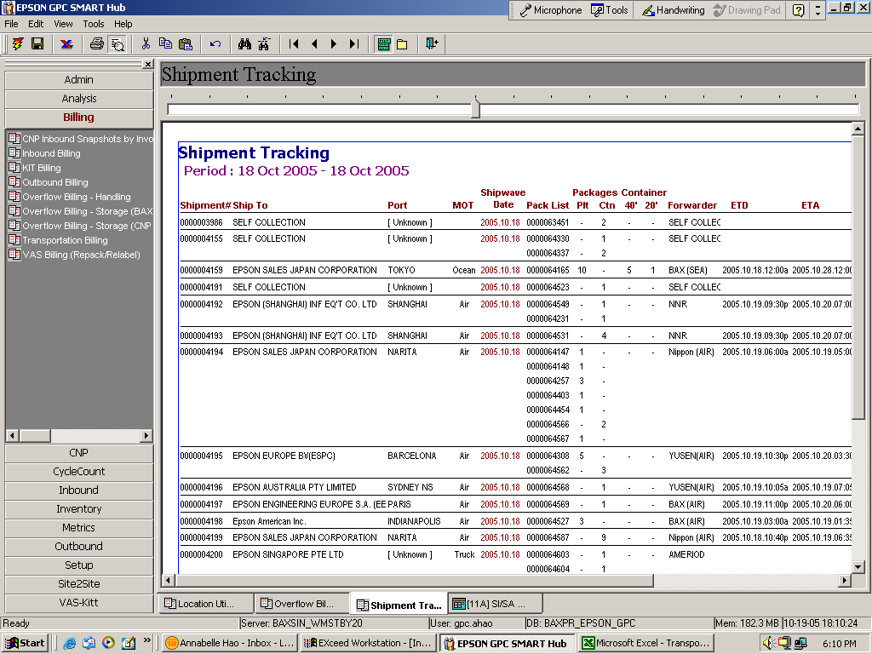
This report is pulled date range as :from “18/10/05” to “18/10/05”, then for waves other than “64165” under shipment # 4159 shipwaved before 18/10/05 will not appear in this report. As such, pls call “Last shipwave date” instead of “First shipwave” date

